Slide 1
Forms in flutter
DMIT 2504 Week 4 day 3

Slide 2





Announcements

Slide 3
Expectations
No Late Assignments
No Cheating
Be a good classmate
Don’t go to stupid sites in class
Show up to class

Slide 4
Forms
Similarly to HTML, forms are everywhere in apps
User input can be captured in a variety of ways
Text fields, radio buttons, check boxes, number fields

Slide 5

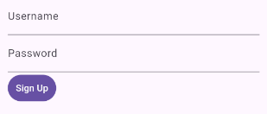
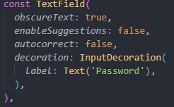
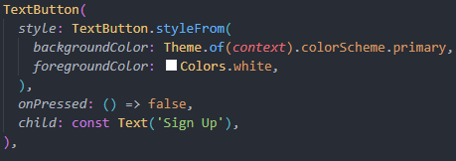
A basic form example

Slide 6




Using the Form widget
The “Form” Widget can be used to manage several “FormField” widgets
It allows you to easily save, validate, and reset every field in the form
You can access the forms state using a key or using Form.of(context)

Slide 7
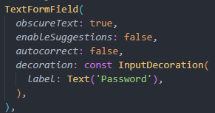
TextFormField Widget
If you need a text input the “TextFormField” widget can be used out of the box with the Form Widget
It’s simply a TextField widget wrapped in a FormField widget

Slide 8

Controllers
To access the current value of an input you need a controller
For text inputs this is done with the TextEditingController class
After creating the instance you assign it to the controller parameter of the formfield widget
You can then access the “.text” value of the controller any time you need the current input value

Slide 9
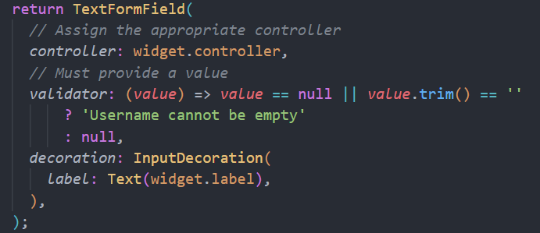
Validators
Each formfield widget can have a validate function to ensure that the input is valid when called
This is passed in to widget as a validator parameter
If the function returns null the input is valid, otherwise it is invalid and will display the returned string as an error message

Slide 10
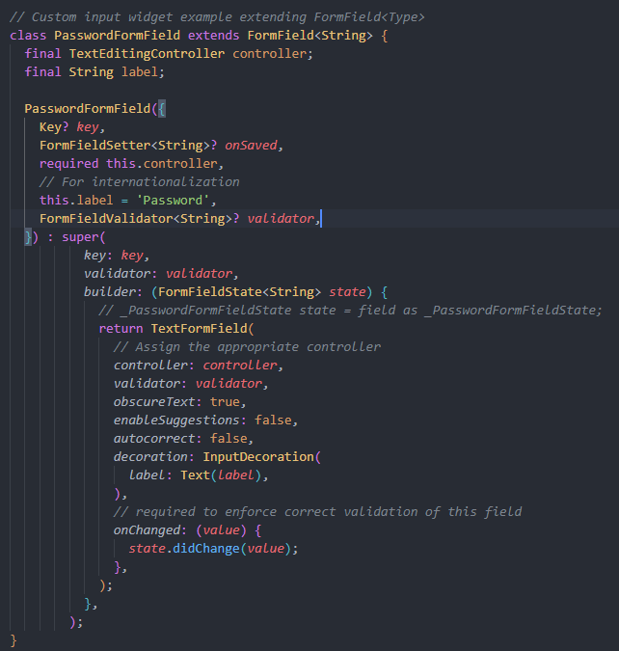
Custom FormField Widgets
From the textbook:
Create a custom widget that extends StatefulWidget (to keep track of the value) and accepts input from the user by encapsulating another input widget, or by customizing the whole process, such as by using gestures.
Create a widget that extends FormField that basically displays the input widget created in the previous step and also exposes its fields.

